Slide 1
Rai et al.

Slide 2
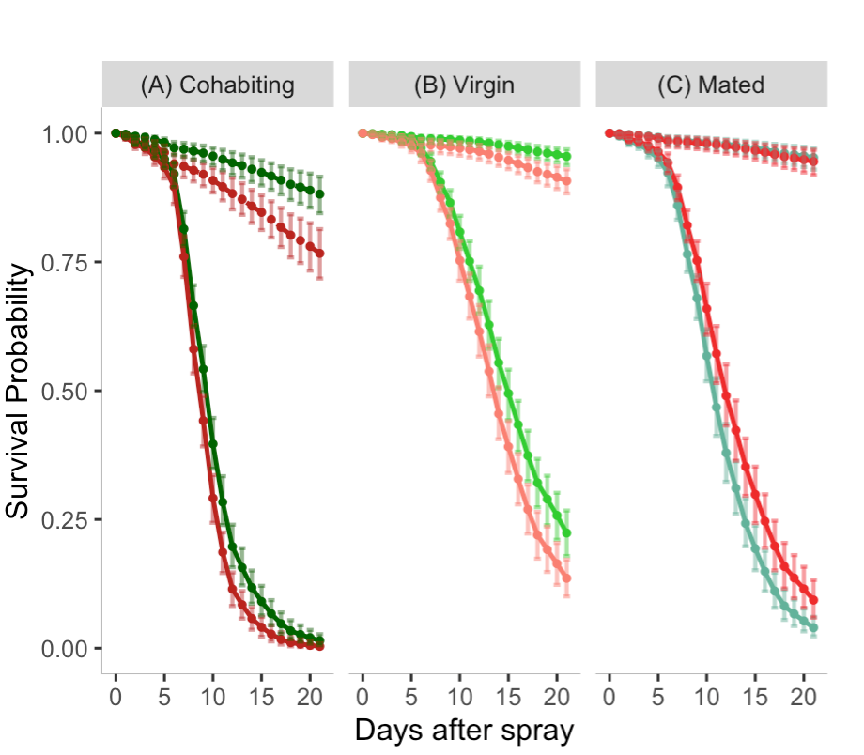
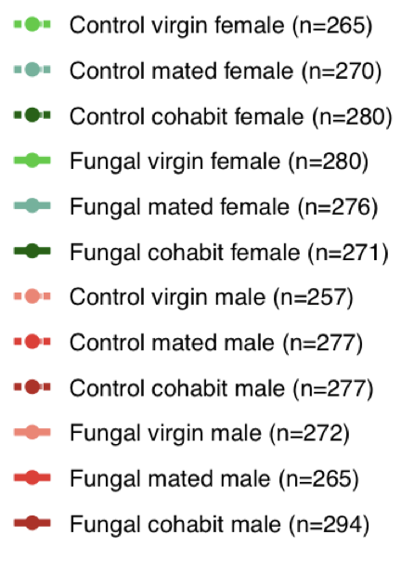
Han check figure legend (in notes section) for accuracy Done
Change headings to include the A, B, C, and change “Cohabit” to “Cohabiting” Done
Change x axis label to “Days after spray” Done
Legend item to cohabiting?
Figure 1.
Notes:
Figure 1. Sexual dimorphism in survival of D. melanogaster inoculated with B. bassiana strain ARSEF 12460 is affected by mating status. Female (green) and male (red) survival after control spray (dashed lines) and fungal spray (solid lines) is shown for cohabiting flies (A), virgin flies (B), and mated flies which mated for only 24 hours (C). Survival was followed for 21 days after the spray. Graphs show model estimates for survival proportions, using four replicates of raw data (Figure S1), with 95% Bootstrap confidence intervals. Sample sizes per treatment are provided in the legend. See Tables S1 and S2 for statistical analysis of this data. For cohabiting and virgin flies, females had better survival than males after inoculation. For mated flies, this trend was reversed. In both females and males, virgin survival was higher than mated survival, which was itself higher than survival under cohabiting conditions, which is more easily seen with separate graphs of female and male survival (Figure S2).

Slide 3
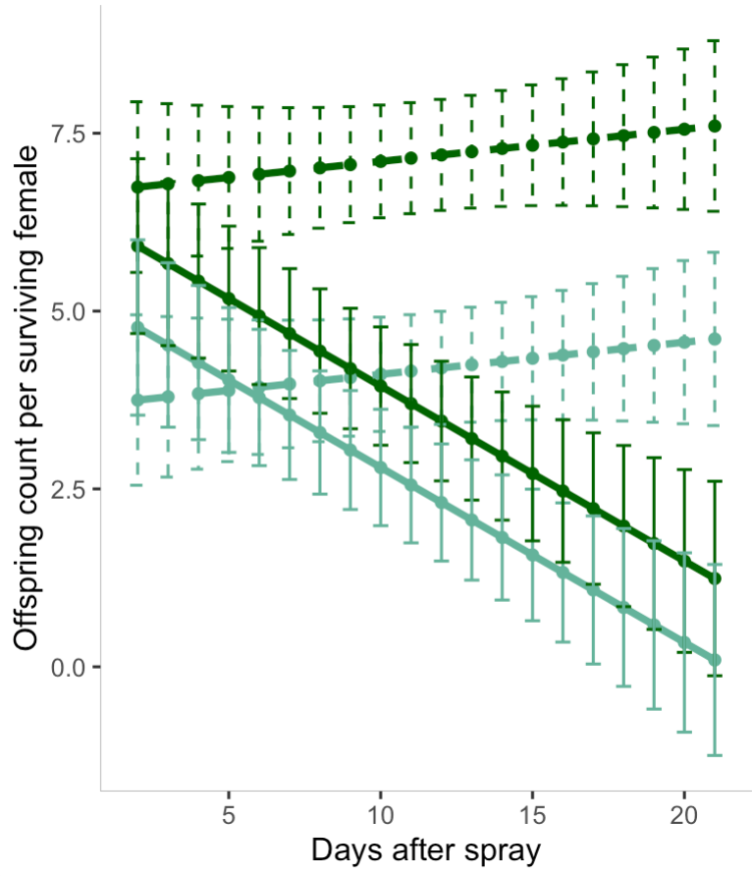
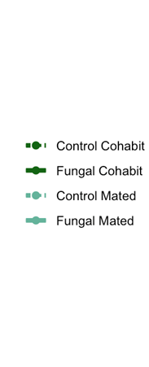
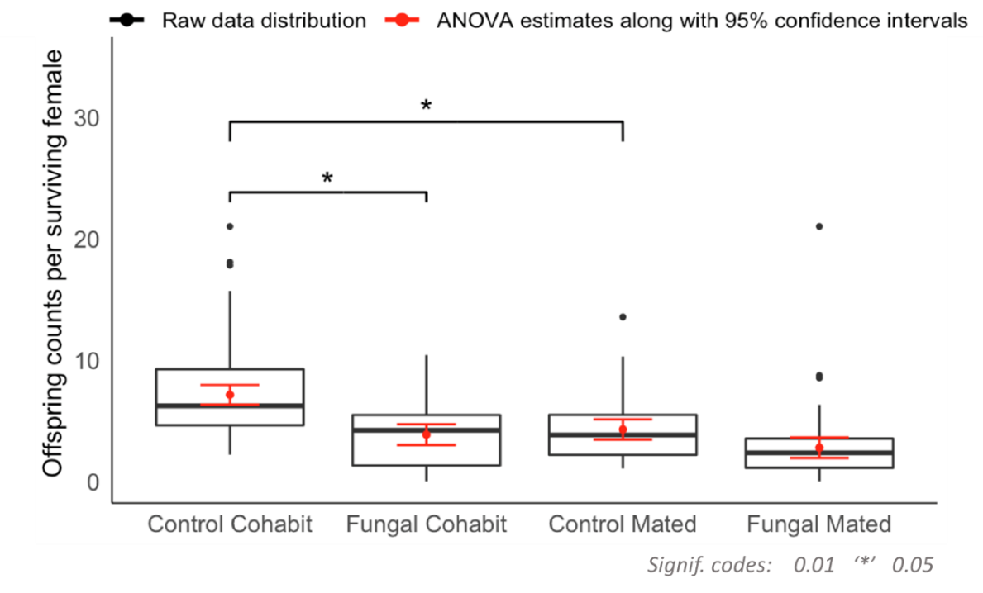
Han check figure legend (in notes section) for accuracy Done
Add “A” and “B” to the figures Done
Change x axis label of “A” to “Days after spray” Done
Is the Y axis of “B” showing mean offspring count per female per day? If so, change the y axis label to reflect this. Done
Legend item to cohabiting?
Figure 2.
A
B
Notes:
Figure 2. Reproductive output of mated and cohabiting females in control and fungal inoculated conditions. (A) Analysis of variance for the offspring counts. The data points are plotted for 95% confidence intervals. Offspring count was lower for fungal-inoculated females than for control females (p-value : $3.313×{10}^{−8}$). Among control females, those that cohabited with males had higher offspring counts compared to those who mated for only 24 hours (p-value: $4.534×{10}^{−6}$). There was an interaction effect between treatment (fungal/control) and mating status (cohabit/mated) with a p-value of $3.725×{10}^{−2}$. (B) Box plot shows the raw data distribution of offspring counts per surviving female and predicted mean value for cohabiting and mated females. Black dots represent the outliers while red lines represents the 95% confidence intervals. Among females in the cohabiting condition, controls had higher offspring count that fungal-inoculated females (p-value: 0.01203), but among mated females, there was no significant difference between offspring counts in control and fungal inoculated conditions (p-value: 0.08702). Among uninfected controls, cohabiting females had higher offspring counts than mated females (p-value: 0.01687). However, among fungal inoculated flies, offspring counts of cohabiting females did not differ from those of mated females (p-value: 0.17707).

Slide 4
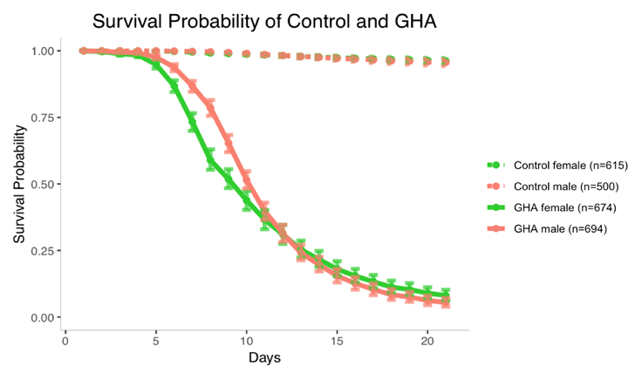
Figure 3.
Han - Change x axis labels to days post spray Done
Check figure legend for accuracy Done
Notes:
Figure 3. Sexual dimorphism in survival of D. melanogaster after inoculation with B. bassiana strain GHA. Figure shows model estimates with 95% Bootstrap confidence intervals from the raw data shown in Figure S3. Inoculated males survived better than inoculated females until day 12 post spray. See Table S2 for statistical analysis.

Slide 5
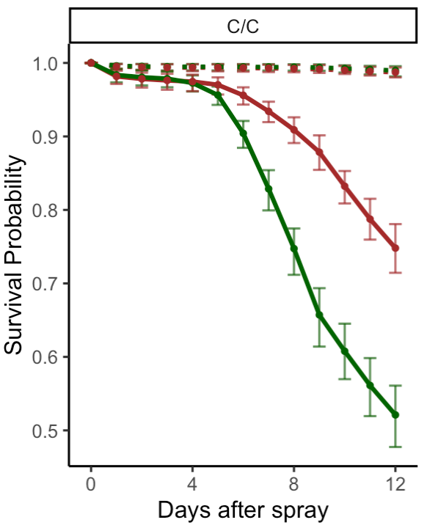
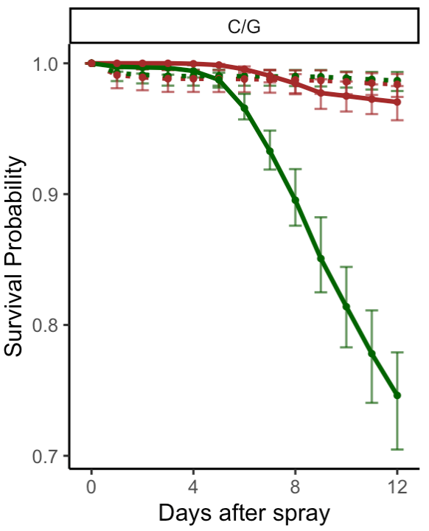
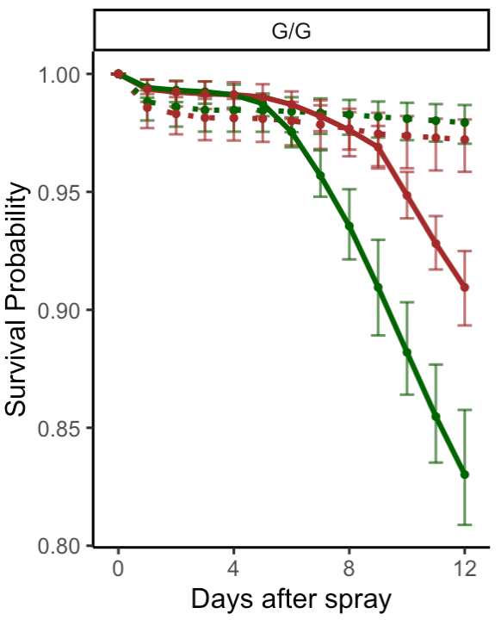
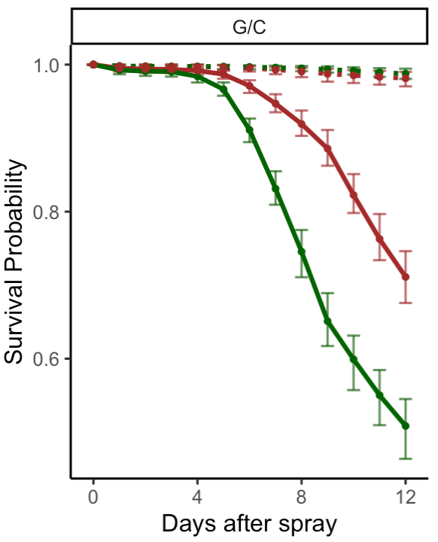
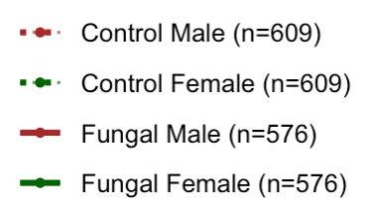
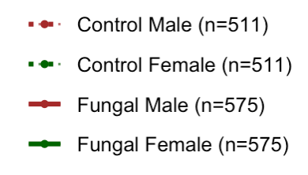
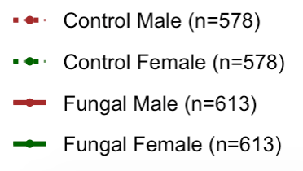
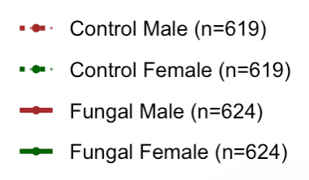
Han –
Cut the data to include only 12 days post inoculation
Add legend and sample sizes to graphs (like in Figures 1, can do separate ones on each graph)
Change the order of graphs to the one shown above, and add axis labels
Change the label of each graph to the ones shown above
Address questions in the notes section of this slide.
Fix y scale.
Figure 4.
Diet 2
Notes:
Figure 4. Diet affects survival of D. melanogaster inoculated with B. bassiana strain GHA.
Analysis questions for Han:
Can we say anything about the magnitude of sexual dimorphism in the analysis?
Does timing of introducing Glucose matter for survival after inoculation?
Summarize the main findings in the figure legend.

Slide 6
Summaries of Figure 4.
Can we say anything about the magnitude of sexual dimorphism in the analysis?
Does timing of introducing Glucose matter for survival after inoculation?
Summarize the main findings in the figure legend.
Sexual Dimorphism
No sexual dimorphism for any diet conditions of control treatment
Sexual dimorphism exists for all diet conditions of fungal treatment at 3-9 days or 3-12 days after spray.
Glucose timing (G/C vs C/G)
Timing of introducing Glucose does matter for survival, and such difference only exists under fungal treatment.
C/G fungal male has a lower risk of death than G/C fungal male.
C/G fungal female has a lower risk of death than G/C fungal female.
Baseline: Control Male | C/C |  |  | C/G |  |  | G/G |  |  | G/C
Days | 0-3 | 3-9 | 9-12 | 0-3 | 3-9 | 9-12 | 0-3 | 3-9 | 9-12 | 0-3 | 3-9 | 9-12
Hazard ratio (p-value) | 0.824 (0.5380) | 0.415 (0.1078) | 0.995 (0.9921) | 0.824 (0.5380) | 0.415 (0.1078) | 0.995 (0.9921) | 0.824 (0.5380) | 0.415 (0.1078) | 0.995 (0.9921) | 0.824 (0.5380) | 0.415 (0.1078) | 0.995 (0.9921)
Baseline: Fungal Male | C/C |  |  | C/G |  |  | G/G |  |  | G/C
Days | 0-3 | 3-9 | 9-12 | 0-3 | 3-9 | 9-12 | 0-3 | 3-9 | 9-12 | 0-3 | 3-9 | 9-12
Hazard ratio (p-value) | 1.406 (0.3212) | 3.445 (8.8818e-14) | 1.097 (0.3933) | 3.661e+05 (0.9763) | 6.898 (2.3674e-07) | 18.414 (2.7779e-06) | 0.248 (0.0877) | 8.683 (5.5560e-06) | 2.606 (0.0003) | 1.406 (0.3212) | 3.445 (8.8818e-14) | 1.097 (0.3933)
Baseline: C/G Male | Control Male |  |  | Fungal Male
Days | 0-3 | 3-9 | 9-12 | 0-3 | 3-9 | 9-12
Hazard ratio (p-value) | 0.240 (0.0356) | 7.031 (0.0750) | 2.062 (0.3020) | 7.153e+05 (0.9750) | 5.231 (2.8430e-06) | 3.117 (9.9104e-08)
Baseline: C/G Female | Control Female |  |  | Fungal Female
Days | 0-3 | 3-9 | 9-12 | 0-3 | 3-9 | 9-12
Hazard ratio (p-value) | 0.240 (0.0356) | 7.031 (0.0750) | 2.062 (0.3020) | 2.746 (0.2084) | 2.613 (1.1562e-08) | 1.857 (0.0004)
Diet 2
Notes:
Figure 4. Diet affects survival of D. melanogaster inoculated with B. bassiana strain GHA.
Analysis questions for Han:
Can we say anything about the magnitude of sexual dimorphism in the analysis?
Does timing of introducing Glucose matter for survival after inoculation?
Summarize the main findings in the figure legend.

Slide 7
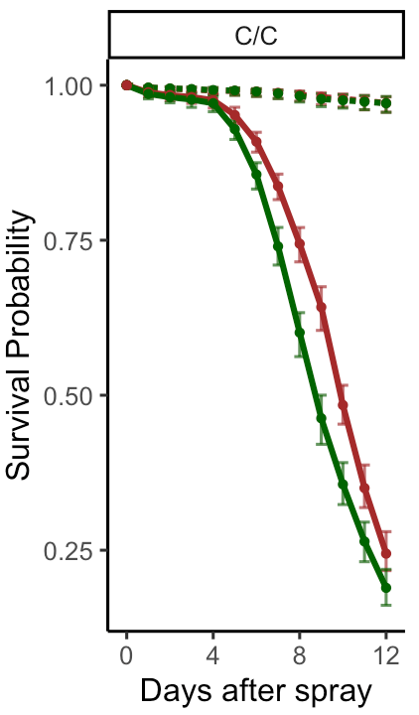
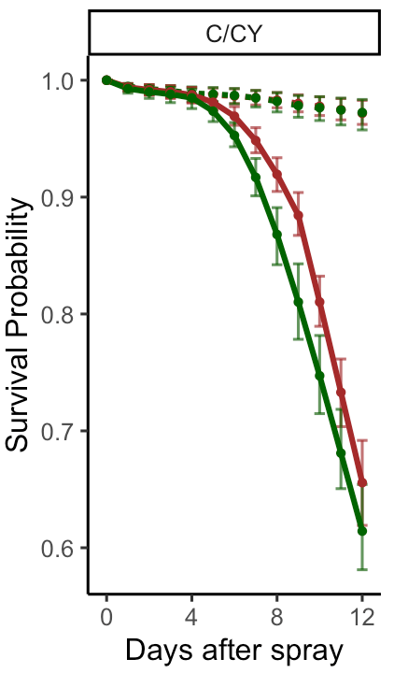
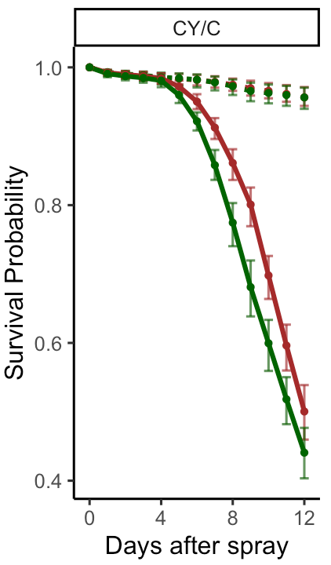
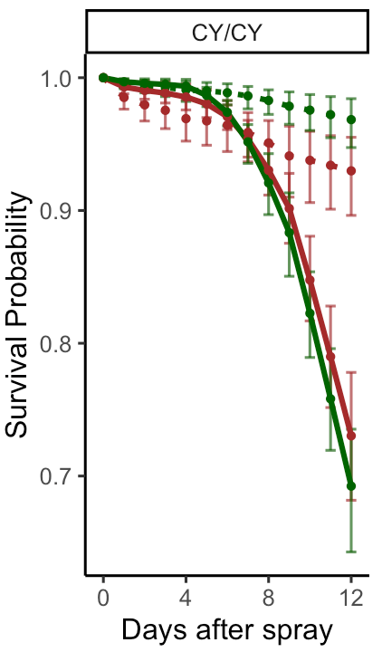
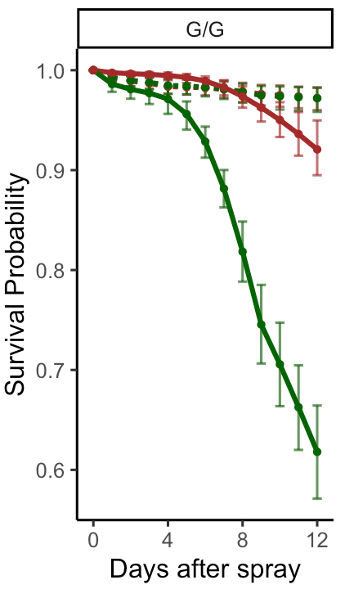
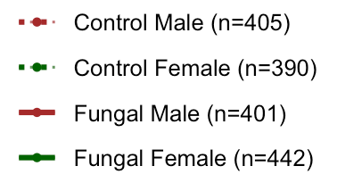
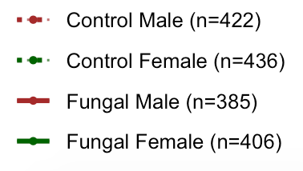
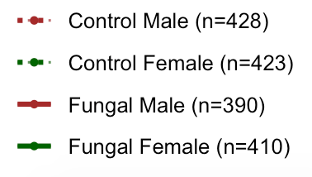
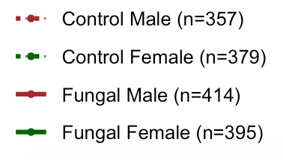

Figure 5.
Han – change figure headings to the ones shown here
Cut the data off after 12 days post spray
Add legend to graphs with sample sizes (like figure 1, can do separate ones on each graph)
Address the questions in the notes section of this slide
Fix y scale
Diet 1
Notes:
Figure 5. Yeast supplementation affects sexual dimorphism in survival of D. melanogaster inoculated with B. bassiana strain GHA. Three days prior to control spray (dashed lines) or fungal spray (solid lines), flies were given Cornmeal (C), Cornmeal with yeast supplement (CY), or Glucose (G) diets, marked before the dash in the figure headings. After the spray on day 15 from egg, flies were kept on one of the three types of diets (marked after the dash in the figure headings).
Can we make these conclusions from the analysis?
Yeast supplement after the spray resulted in higher survival than cornmeal diet after spray
Sexual dimorphism was ablated when yeast supplement was given before and after spray
Female survival was the same when given yeast supplement after spray or when on glucose diet, but male survival was better on glucose diet
Sexual dimorphism was most pronounced on glucose diet

Slide 8
Yeast supplement after the spray resulted in higher survival than cornmeal diet after spray
Summaries of Figure 5.
Yeast supplement
Yeast after spray resulted in higher survival than cornmeal diet after spray on fungal treatment only. No such difference between control flies.
Baseline: C/CY |  | Control |  |  | Fungal
Days |  | 0-4 | 4-9 | 9-12 | 0-4 | 4-9 | 9-12
C/C Male | Hazard ratio (p-value) | 0.693 (0.5725) | 2.610 (0.2577) | 5.252 (0.2577) | 1.734 (0.3288) | 4.577 (6.0606e-10) | 2.991 (8.4623e-11)
C/C Female | Hazard ratio (p-value) | 0.693 (0.5725) | 2.610 (0.2577) | 5.252 (0.2577) | 1.591 (0.3339) | 3.547 (2.2922e-12) | 3.526 (6.0437e-11)
Baseline: CY/CY |  | Control |  |  | Fungal
Days |  | 0-4 | 4-9 | 9-12 | 0-4 | 4-9 | 9-12
CY/C Male | Hazard ratio (p-value) | 0.376 (0.0765) | 0.569 (0.2593) | 1.209 (0.7702) | 0.703 (0.5882) | 2.560 (3.0444e-5) | 2.249 (2.5324e-06)
CY/C Female | Hazard ratio (p-value) | 0.376 (0.0765) | 0.569 (0.2593) | 1.209 (0.7702) | 0.435 (0.3104) | 3.022 (1.4657e-07) | 1.833 (0.0003)
Diet 1
Notes:
Figure 5. Yeast supplementation affects sexual dimorphism in survival of D. melanogaster inoculated with B. bassiana strain GHA. Three days prior to control spray (dashed lines) or fungal spray (solid lines), flies were given Cornmeal (C), Cornmeal with yeast supplement (CY), or Glucose (G) diets, marked before the dash in the figure headings. After the spray on day 15 from egg, flies were kept on one of the three types of diets (marked after the dash in the figure headings).
Can we make these conclusions from the analysis?
Yeast supplement after the spray resulted in higher survival than cornmeal diet after spray
Sexual dimorphism was ablated when yeast supplement was given before and after spray
Female survival was the same when given yeast supplement after spray or when on glucose diet, but male survival was better on glucose diet
Sexual dimorphism was most pronounced on glucose diet

Slide 9
Sexual dimorphism was ablated when yeast supplement was given before and after spray
Female survival was the same when given yeast supplement after spray or when on glucose diet, but male survival was better on glucose diet
Sexual dimorphism was most pronounced on glucose diet
Summaries of Figure 5.
II. Sexual dimorphism
Sexual dimorphism exists (female survives better) for CY/CY group from day 0-9 after spray under control treatment, but it does not exist under fungal treatment.
Sexual dimorphism exists (male survives better) for C/C group from day 3-9 after spray under fungal treatment, but it does not exist under control treatment. Same results for CY/C group.
Sexual dimorphism exists (male survives better) for G/G group from day 3-12 after spray under fungal treatment, but it does not exist under control treatment.
Baseline: Control Male | C/C |  |  | C/CY |  |  | CY/C |  |  | CY/CY |  |  | G/G
Days | 0-3 | 3-9 | 9-12 | 0-3 | 3-9 | 9-12 | 0-3 | 3-9 | 9-12 | 0-3 | 3-9 | 9-12 | 0-3 | 3-9 | 9-12
Hazard ratio (p-value) | 1.300 (0.2228) | 0.880 (0.7970) | 0.680 (0.4515) | 0.901 (0.8189) | 2.296 (0.2665) | 3.569 (0.2228) | 1.09 (0.8538) | 0.661 (0.3448) | 0.594 (0.9770) | 0.412 (0.0175) | 0.376 (0.0138) | 0.718 (0.5546) | 1.081 (0.8734) | 0.570 (0.1805) | 7.709e+05 (0.9700)
Baseline: Fungal Male | C/C |  |  | C/CY |  |  | CY/C |  |  | CY/CY |  |  | G/G
Days | 0-3 | 3-9 | 9-12 | 0-3 | 3-9 | 9-12 | 0-3 | 3-9 | 9-12 | 0-3 | 3-9 | 9-12 | 0-3 | 3-9 | 9-12
Hazard ratio (p-value) | 1.215 (0.6606) | 1.832 (1.4197e-06) | 0.950 (0.6735) | 1.324 (0.2228) | 2.364 (0.2228) | 0.806 (0.1728) | 1.434 (0.5796) | 1.549 (0.0040) | 0.915 (0.4867) | 0.871 (0.6606) | 1.312 (0.2391) | 1.123 (0.4867) | 1.193 (0.7279) | 10.748 (2.0011e-08) | 5.126 (1.8983e-06)
Diet 1
Notes:
Figure 5. Yeast supplementation affects sexual dimorphism in survival of D. melanogaster inoculated with B. bassiana strain GHA. Three days prior to control spray (dashed lines) or fungal spray (solid lines), flies were given Cornmeal (C), Cornmeal with yeast supplement (CY), or Glucose (G) diets, marked before the dash in the figure headings. After the spray on day 15 from egg, flies were kept on one of the three types of diets (marked after the dash in the figure headings).
Can we make these conclusions from the analysis?
Yeast supplement after the spray resulted in higher survival than cornmeal diet after spray
Sexual dimorphism was ablated when yeast supplement was given before and after spray
Female survival was the same when given yeast supplement after spray or when on glucose diet, but male survival was better on glucose diet
Sexual dimorphism was most pronounced on glucose diet

Slide 10
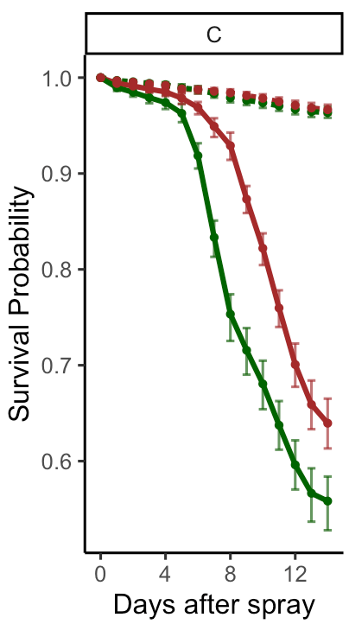
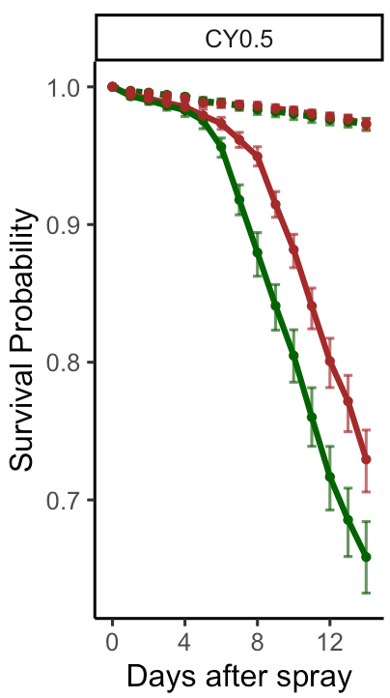
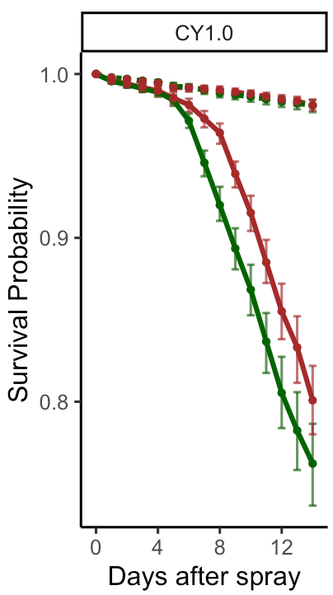
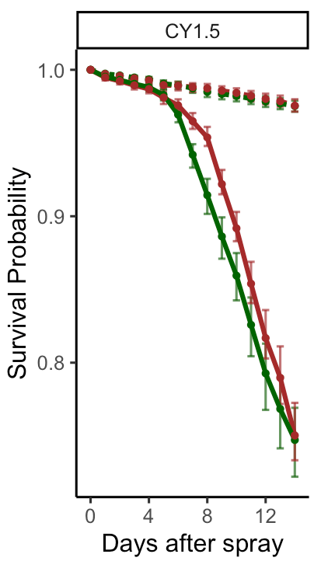
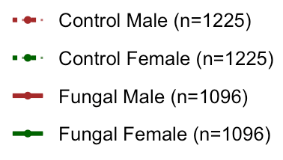
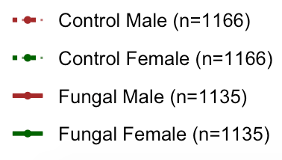
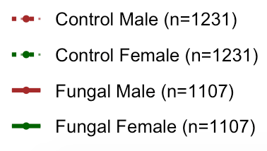
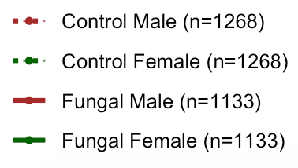
Han
Is there a way to compare magnitude of sexual dimorphism?
Add sample sizes and legends per graph similar to figure 1
Answer questions in the notes section of this slide
Cut off at 12
Figure 6.
Notes:
Figure 6: Concentration of yeast supplement after the spray affects survival of D. melanogaster inoculated with B. bassiana.
Is there a way to compare magnitude of sexual dimorphism in the different diet treatments?
Are survivals of males and females the same in the yeast treatments? Can we say that yeast supplement up to 1.0 improved survival but then didn’t when we added even more?
Update the figure legend with summary of statistical analysis findings

Slide 11
Is there a way to compare magnitude of sexual dimorphism in the different diet treatments?
Are survivals of males and females the same in the yeast treatments?
Summaries of Figure 6.
Sexual dimorphism
Sexual dimorphism does not exist under control treatment.
Sexual dimorphism exist under fungal treatment for all diet conditions, all between 5-8 days after spray. But the difference within groups of diet C and diet CY.5 starts earlier.
Baseline: Control Male | C |  |  | CY0.5 |  |  | CY1.0 |  |  | CY1.5
Days | 0-5 | 5-8 | 8-12 | 0-5 | 5-8 | 8-12 | 0-5 | 5-8 | 8-12 | 0-5 | 5-8 | 8-12
Hazard ratio (p-value) | 1.065 (0.7612) | 1.145 (0.6556) | 1.030 (0.9010) | 1.065 (0.7612) | 1.145 (0.6556) | 1.030 (0.9010) | 1.065 (0.7612) | 1.145 (0.6556) | 1.030 (0.9010) | 1.065 (0.7612) | 1.145 (0.6556) | 1.030 (0.9010)
Baseline: Control Female | C |  |  | CY0.5 |  |  | CY1.0 |  |  | CY1.5
Days | 0-5 | 5-8 | 8-12 | 0-5 | 5-8 | 8-12 | 0-5 | 5-8 | 8-12 | 0-5 | 5-8 | 8-12
Hazard ratio (p-value) | 1.711 (0.0261) | 4.794 (5.9931e-10) | 0.854 (0.1147) | 0.936 (0.0261) | 4.404 (2.4345e-09) | 1.192 (0.1002) | 0.938 (0.7534) | 2.805 (3.5543e-07) | 1.043 (0.6100) | 0.938 (0.7534) | 2.805 (3.5543e-07) | 1.043 (0.6100)
Notes:
Figure 6: Concentration of yeast supplement after the spray affects survival of D. melanogaster inoculated with B. bassiana.
Is there a way to compare magnitude of sexual dimorphism in the different diet treatments?
Are survivals of males and females the same in the yeast treatments? Can we say that yeast supplement up to 1.0 improved survival but then didn’t when we added even more?
Update the figure legend with summary of statistical analysis findings

Slide 12
Figure 6.
II. yeast supplement up to 1.0 improved survival but then didn’t when we added even more?
CY0.5 survives better than C diet.
CY1.0 survives better than CY0.5.
Such difference within first two pairs appears on female flies (begins at day 0 or 5) earlier than males (begins at day 5 or 8).
No difference between CY1.0 and CY1.5.
 |  | C (baseline) vs CY0.5 |  |  | CY0.5 (baseline) vs CY1.0 |  |  | CY1.0 (baseline) vs CY1.5
Days |  | 0-5 | 5-8 | 8-12 | 0-5 | 5-8 | 8-12 | 0-5 | 5-8 | 8-12
Fungal Male | Hazard ratio (p-value) | 1.303 (0.3577) | 0.283 (0.0243) | 0.508 (0.0113) | 0.931 (0.7229) | 1.002 (0.9941) | 0.676 (0.0009) | 0.899 (0.5556) | 1.290 (0.0768) | 1.268 (0.0768)
Fungal Female | Hazard ratio (p-value) | 0.537 (0.0243) | 0.496 (8.3668e-07) | 0.749 (0.0113) | 0.883 (0.6568) | 0.464 (1.4921e-05) | 0.644 (0.0004) | 0.899 (0.5556) | 1.290 (0.0768) | 1.268 (0.0768)
Notes:
Figure 6: Concentration of yeast supplement after the spray affects survival of D. melanogaster inoculated with B. bassiana.
Is there a way to compare magnitude of sexual dimorphism in the different diet treatments?
Are survivals of males and females the same in the yeast treatments? Can we say that yeast supplement up to 1.0 improved survival but then didn’t when we added even more?
Update the figure legend with summary of statistical analysis findings

Slide 13
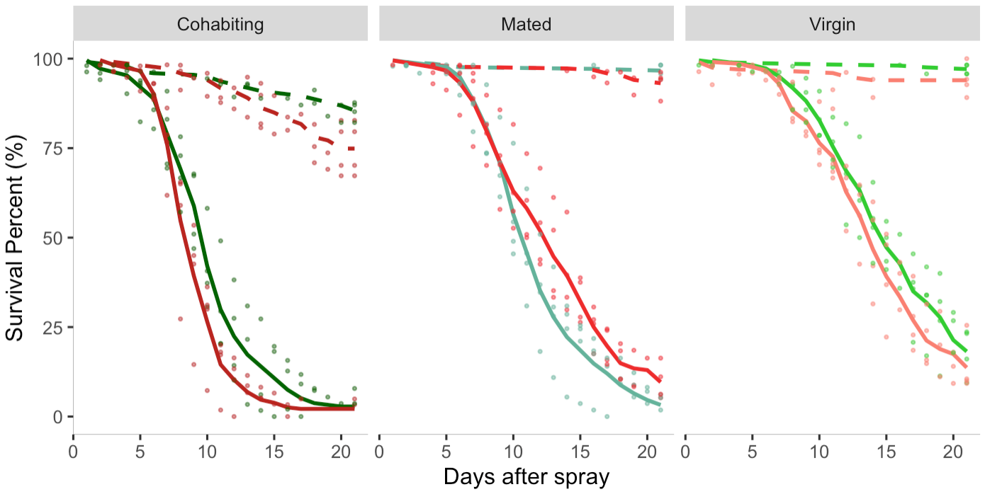
Figure S1.
Han – plot the raw data for Figure 1 showing data points from all replicates and the trend lines, in the same format as figure 1. Legend item to cohabiting?
Notes:
Figure S1. Raw data showing survival percentage of virgin, mated and cohabiting males and females under fungal inoculated and control conditions.

Slide 14
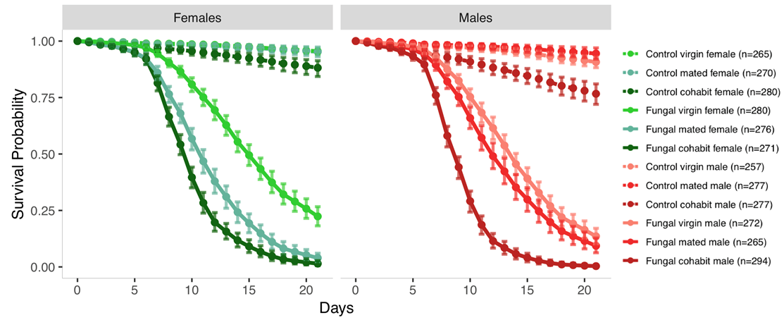
Figure S2.
Legend item to cohabiting?
Notes:
Figure S2. Survival post inoculation with Beauveria bassiana is affected by mating status in both males and females. Flies were sprayed with fungal suspension (n = 1658, solid lines) or with a control, fungus-free suspension (n = 1626, dashed lines) at age 17 days from egg, and survival was followed for 21 days. In both females (green) and males (red), mated flies (which mated for 24 hours prior to the spray) had lower survival than virgin flies, and flies that mated for longer than one day (cohabiting flies, which mated for 24 hours prior to spray and then cohabited with the other sex after the spray) had lower survival than mated flies (see Table S1 for statistical analysis). This figure shows model estimates for survival proportions, which are obtained from the raw survival data (Figure S1).

Slide 15
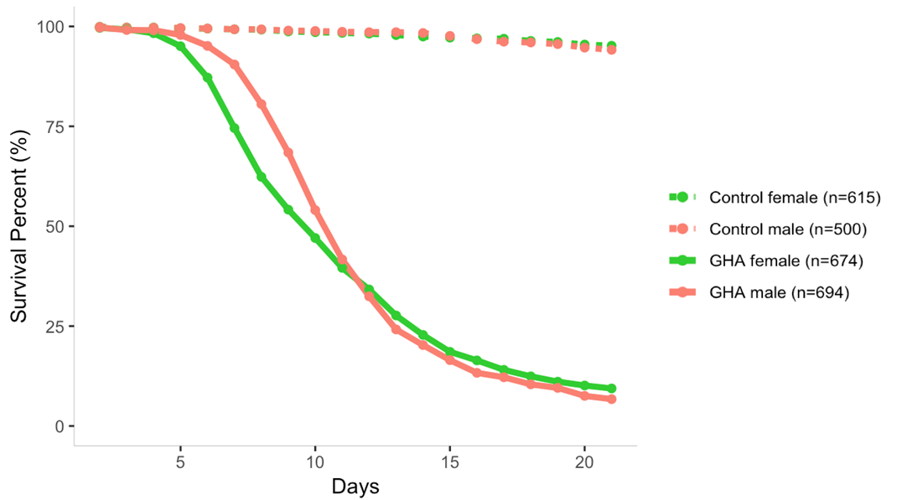
Figure S3.
Han – add the data points for all replicates on top of these trend lines and get rid of the mean points.
Notes:
Figure S3. Raw data showing survival percentage of control and GHA inoculated males
and females. Data from three replicates are combined.

Slide 16
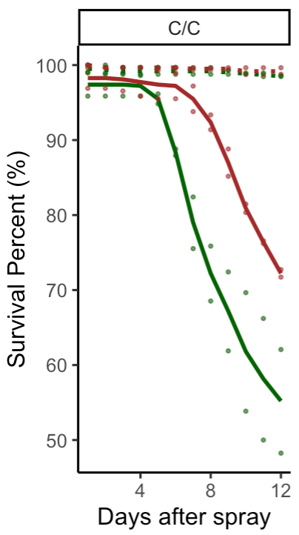
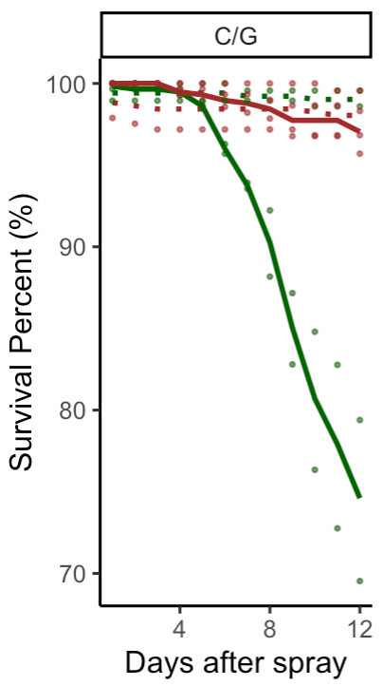
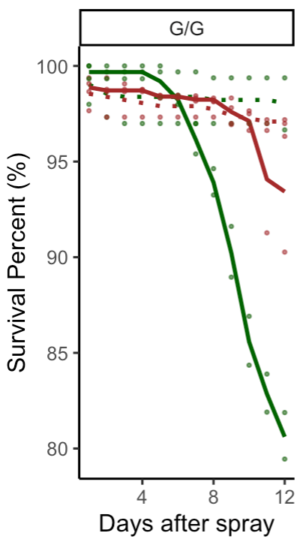
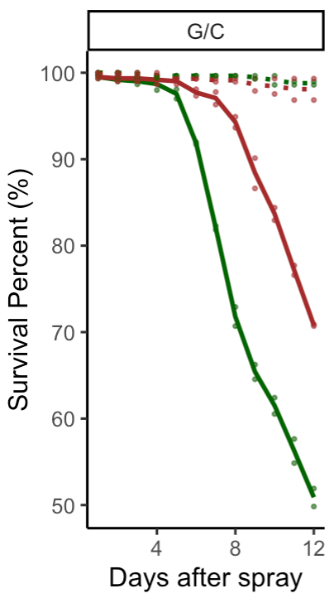
Figure S4.
Han – plot the raw data for Figure 4 showing data points from all replicates and the trend lines, in the same format as figure 4.

Slide 17
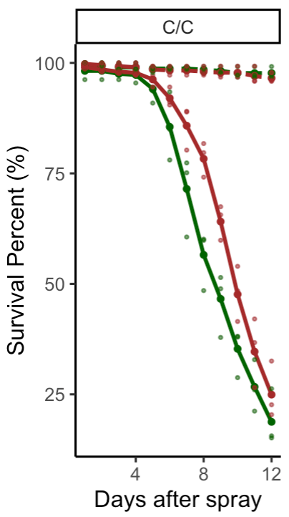
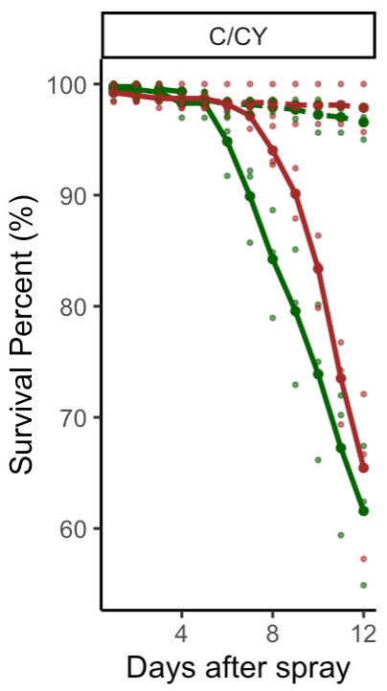
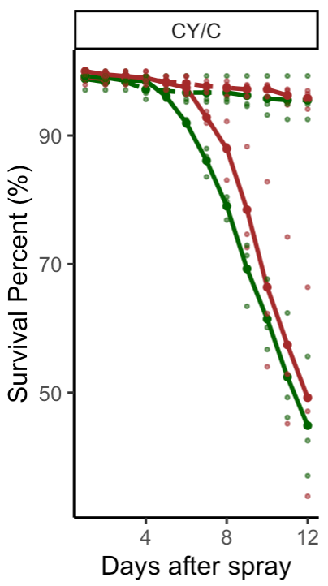
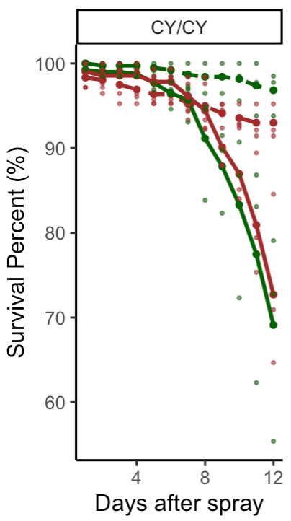
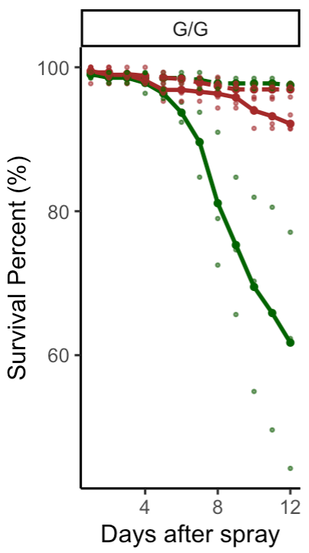
Figure S5.
Han – plot the raw data for Figure 5 showing data points from all replicates and the trend lines, in the same format as figure 5.

Slide 18
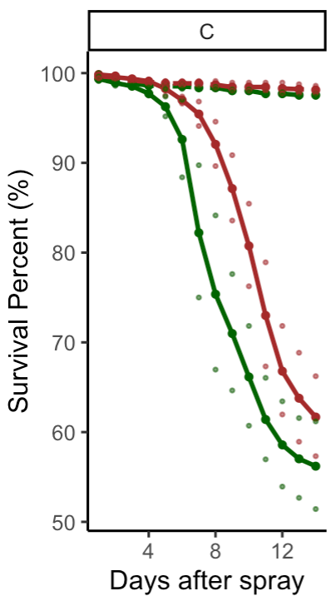
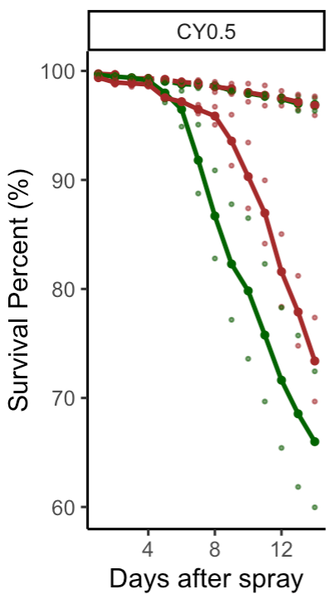
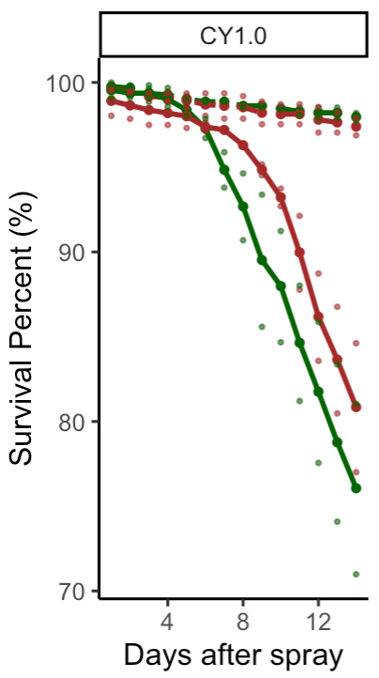
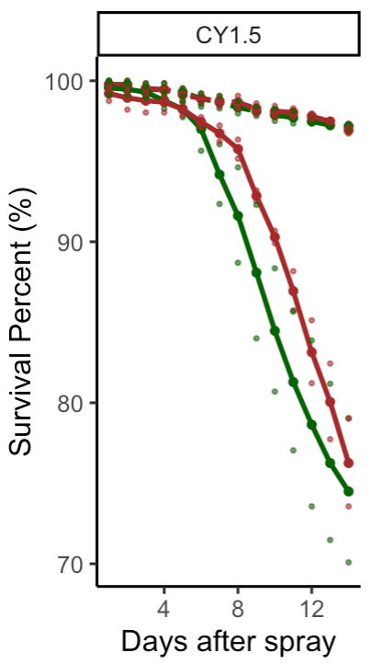
Figure S6.
Han – plot the raw data for Figure 6 showing data points from all replicates and the trend lines, in the same format as figure 6.

Slide 19
Table S1. Hazard Ratios and p-Values when Comparing Mating Statuses in Both Control and Fungal Inoculated Drosophila Melanogaster
Treatment | Sex | Hazard ratios between mating status | 0 – 5 | 5 – 11 | 11 – 21
Control | Female | Mated vs Virgins (p-value) | 1.28 (0.4978) | 1.24 (0.4446) | 0.93 (0.8012)
Control | Female | Cohabit vs Virgins (p-value) | 2.79 (0.0014) | 4.59 (<0.0001) | 2.29 (<0.0001)
Control | Female | Cohabit vs Mated (p-value) | 2.19 (0.0219) | 3.69 (0.0003) | 2.46 (0.0046)
Control | Male | Mated vs Virgins (p-value) | 0.70 (0.3297) | 0.69 (0.1956) | 0.52 (0.0238)
Control | Male | Cohabit vs Virgins (p-value) | 2.79 (0.0014) | 4.59 (<0.0001) | 2.29 (<0.0001)
Control | Male | Cohabit vs Mated (p-value) | 3.96 (0.0005) | 6.69 (<0.0001) | 4.45 (<0.0001)
Fungal | Female | Mated vs Virgins (p-value) | 2.72 (0.0041) | 2.65 (<0.0001) | 1.99 (<0.0001)
Fungal | Female | Cohabit vs Virgins (p-value) | 2.79 (0.0014) | 4.59 (<0.0001) | 2.29 (<0.0001)
Fungal | Female | Cohabit vs Mated (p-value) | 1.03 (0.9073) | 1.73 (0.0001) | 1.15 (0.3419)
Fungal | Male | Mated vs Virgins (p-value) | 1.50 (0.1854) | 1.46 (0.0098) | 1.10 (0.4450)
Fungal | Male | Cohabit vs Virgins (p-value) | 2.79 (0.0014) | 4.59 (<0.0001) | 2.29 (<0.0001)
Fungal | Male | Cohabit vs Mated (p-value) | 1.86 (0.0178) | 3.14 (<0.0001) | 2.09 (0.0002)
Notes:
Hazard ratios and p-values are presented from 0-5, 5-11 and 11-21 days post inoculation using the model (see Equation 1.1 and Table S1).

Slide 20
Table S2. Hazard Ratios and p-Values when Comparing Males and Females under Different Mating Statuses in Both Control and Fungal Drosophila melanogaster
Treatment | Mating status | Hazard ratios between sex | 0 – 21
Control | Virgins | Male vs Female (p-value) | 2.11 (0.0016)
Control | Mated | Male vs Female (p-value) | 1.16 (0.4805)
Control | Cohabit | Male vs Female (p-value) | 1.33 (0.0013)
Fungal | Virgins | Male vs Female (p-value) | 2.11 (0.0016)
Fungal | Mated | Male vs Female (p-value) | 0.74 (0.0084)
Fungal | Cohabit | Male vs Female (p-value) | 1.33 (0.0013)
Notes:
Hazard ratios and p-values are presented for days 0-21 post infection, using the model shown in Equation 1.1 and Table S1.

Slide 21
Table S3. Analysis of Variance Table for Offspring Data from Mated and Cohabit Females
 | Df | Sum Sq | Mean Sq | F value | Pr(>F)
Day | 1 | 55.19 | 55.19 | 5.8532 | 0.01634*
Treatment | 1 | 363.70 | 363.70 | 38.5723 | 2.505e-09***
Mating_status | 1 | 229.53 | 229.53 | 24.3426 | 1.564e-06***
Treatment:Mating_status | 1 | 47.40 | 47.40 | 5.0270 | 0.02593*
Day:Treatment | 1 | 163.88 | 163.88 | 17.3799 | 4.361e-05***
Residuals | 226 | 2130.98 | 9.43
Notes:
Significantly smaller p-value of Treatment ($2.505×{10}^{−9}$) indicates that the data strongly supports the difference on offspring counts between the fungal inoculated groups and the controls. The data also strongly supports that cohabiting and mated groups differ in their offspring counts (p-value: $1.564×{10}^{−6}$).
* p-value ≤ 0.05, *** p-value ≤ 0.001

Slide 22
Table S4. Hazard Ratios and p-Values for Males vs Females in GHA Inoculated Flies.
Baseline: Female | 0 - 8 | 8 - 12 | 12 - 21
Hazard ratio (p-value) | 0.403 (0.00043) | 1.268 (0.03486) | 1.245 (0.07487)
Notes:
p-values were significantly small at 0-8 days (0.00043) and 8-12 days (0.03486), which indicate that the data strongly supports the sexual dimorphism post infection at an early stage. However the p-value between 12-21 days (0.07487) shows that the data does not strongly support for the sexual dimorphism post infection during this period. The hazard ratios (0-8 days: 0.403, 8-12 days :1.268 and 12-21 days: 1.245) indicate the risk of male flies dying post infection in comparison to the female flies.

Slide 23
Table S5. Hazard Ratios and p-Values Comparing Males and Females Fed Under Different Dietary Conditions in Both Control and Fungal Drosophila melanogaster.
Han - Update this analysis (12 days post spray only, treatments listed in paper draft only)
Baseline: Male | 0-3 | 3-9 | 9-12
A Diet: Cornmeal, Cornmeal
Control (p-value) | 0.824 (0.5380) | 0.415 (0.1078) | 0.995 (0.9921)
Fungal (p-value) | 1.406 (0.3212) | 3.445 (8.8818e-14) | 1.097 (0.3933)
B Diet: Cornmeal, Glucose
Control (p-value) | 0.824 (0.5380) | 0.415 (0.1078) | 0.995 (0.9921)
Fungal (p-value) | 3.661e+05 (0.9763) | 6.898 (2.3674e-07) | 18.414 (2.7779e-06)
C Diet: Glucose, Glucose
Control (p-value) | 0.824 (0.5380) | 0.415 (0.1078) | 0.995 (0.9921)
Fungal (p-value) | 0.248 (0.0877) | 8.683 (5.5560e-06) | 2.606 (0.0003)
C Diet: Glucose, Glucose
Control (p-value) | 0.824 (0.5380) | 0.415 (0.1078) | 0.995 (0.9921)
Fungal (p-value) | 1.406 (0.3212) | 3.445 (8.8818e-14) | 1.097 (0.3933)
Diet 2
Notes:
Hazard ratios and p-values are presented for days 0-4, 4-9 and 9-14 days post infection, using the model shown in Equation 2.1 and Table 2.2.

Slide 24
Table S6. Hazard Ratios and p-Values when Comparing Various Diets in Both Males and Females of Fungal Inoculated Drosophila melanogaster
Han - Update this analysis (12 days post spray only, treatments listed in paper draft only)
Baseline: C, C + Y |  | 0 – 4 | 4 - 9 | 9 - 12
Female
Hazard ratio (p-value) | C + Y, C + Y | 0.735 (0.6023) | 0.549 (0.0029) | 0.921 (0.6210)
 | C + Y, C | 0.850 (0.7731) | 1.658 (0.0012) | 1.689 (0.0014)
 | G, G | 1.270 (0.6376) | 1.233 (0.1817) | 0.781 (0.1717)
 | C, C | 1.591 (0.3339) | 3.547 (2.2922e-12) | 3.526 (6.0437e-11)
Male
Hazard ratio (p-value) | C + Y, C + Y | 1.118 (0.8549) | 0.989 (0.9634) | 0.661 (0.0111)
 | C + Y, C | 0.786 (0.7215) | 2.531 (4.9408e-05) | 1.487 (0.0065)
 | G, G | 1.409 (0.5603) | 0.271 (0.0012) | 0.123 (3.3820e-09)
 | C, C | 1.734 (0.3288) | 4.577 (6.0606e-10) | 2.991 (8.4623e-11)
Diet 1
Notes:
Hazard ratios and p-values are presented from 0-4, 4-9 and 9-14 days post inoculation using the model shown in Equation 2.1 and Table 2.2.

Slide 25
Treatment | Sex | Hazard ratios between diet | 0 – 3 | 3 – 9 | 9 – 12
Control | Male | C/C (baseline) | 1 | 1 | 1
Control | Male | C/G (p-value) | 1.880 (0.2006) | 0.600 (0.2006) | 0.718 (0.6529)
Control | Male | G/C (p-value) | 0.451 (0.6529) | 4.222 (0.0776) | 1.480 (0.5077)
Control | Male | G/G (p-value) | 2.970 (0.0178) | 2.997 (0.1880) | 0.598 (0.1880)
Fungal | Male | C/C (p-value) | 3.015 (0.0310) | 0.484 (7.4350e-06) | 0.443 (7.4350e-06)
Fungal | Male | C/G (p-value) | 1.507e-06 (0.975) | 9.821 (0.0059) | 1.714 (0.4535)
Fungal | Male | G/C (p-value) | 1.078 (0.4535) | 0.514 (5.7886e-06) | 0.534 (6.0005e-09)
Fungal | Male | G/G (p-value) | 2.046 (6.0005e-09) | 4.894 (0.0604) | 0.105 (1.2770e-04)
Table S7
Han - Update this analysis (12 days post spray only, treatments listed in paper draft only)
Diet 2
Notes:
Table []: Statistical data from comparing males from all dietary conditions.

Slide 26
Treatment | Sex | Hazard ratios between diet | 0 – 3 | 3 – 9 | 9 – 12
Control | Female | C/C (baseline) | 1 | 1 | 1
Control | Female | C/G (p-value) | 1.880 (0.2006) | 0.600 (0.2006) | 0.718 (0.6529)
Control | Female | G/C (p-value) | 0.451 (0.6529) | 4.222 (0.0776) | 1.480 (0.5077)
Control | Female | G/G (p-value) | 2.970 (0.0178) | 2.997 (0.1880) | 0.598 (0.1880)
Fungal | Female | C/C (p-value) | 5.139 (0.0017) | 4.018e+02 (1.4367e-08) | 4.879e+01 (1.4367e-08)
Fungal | Female | C/G (p-value) | 0.669 (0.6275) | 1.633e+02 (3.9775e-07) | 3.172e+01 (1.5777e-07)
Fungal | Female | G/C (p-value) | 1.838 (0.2678) | 4.266e+02 (1.1544e-08) | 5.892e+01 (1.5777e-07)
Fungal | Female | G/G (p-value) | 0.617 (0.5600) | 1.024e+02 (2.3133e-06) | 6.794e+01 (2.6628e-05)
Table S8
Han - Update this analysis (12 days post spray only, treatments listed in paper draft only)
Diet 2
Notes:
Table []: Statistical data from comparing females from all dietary conditions.

Slide 27
Table S9
Han – add table summary of analysis of experiment 5 in paper draft
Slide #11 - #12
Diet 3

